Slide 1
WEBPHISHING DETECTION
Submitted by,
Renjini.R.L(963819104005)
Felsy Jazreel Sam
Jincy.C(963819104004)
Benisha.B(963819104003)
AncyS.L(963819104002)
Department of Computer science and Engineering
Good Shepherd College of Engineering and Technology, Maruthamparai.

Slide 2
content
Introduction
Objectives
Definition, motives , importance
Mitigation of phishing attacks
Detection of phishing attacks
Evaluation of phishing techniques
Conclusion
References

Slide 3
INTRODUCTION
PHISHING is a social engineering attack that aims at exploiting the weakness found in system processes as caused by system users.
For eg. User leak their passwords if an attacker asked them to update via http link.
Due to the broad nature of the phishing problem, this phishing detection survey was began.

Slide 4
OBJECTIVES
Definitions
Phishing campaign
Evaluation metrics
Detection
Evaluation

Slide 5
DEFINITIONS
"Phishing is a fraudulent attempt, usually made through email, to steal your personal information".
"We define a phishing page as any webpage that, without permission, alleges to act on behalf of a third party with the intention of confusing viewers into performing an action with which the viewer would only trust a true agent of the third party".
Phishing is a type of computer attack that communicates socially engineered messages to humans via electronic communication channels in order to persuade them to perform certain actions for the attacker's benefit.

Slide 6
PHISHING MOTIVES
The primary motives behind phishing attacks, from an attackers perspective, are:
Financial gain: Phishers can use stolen banking credentials to their financial benefits.
Identity hiding: Instead of using stolen identities directly, phishers might sale the identities to others whom might be criminals seeking ways to hide their identities and activities.
Fame and Notoriety: Phishers might attack victims for the sake of peer recognition.

Slide 7

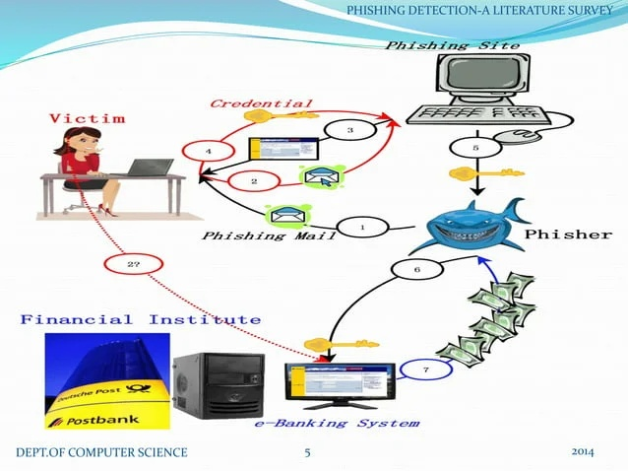
Example:
Phishing site

Slide 8
IMPORTANCE
According to APWG, phishing attacks where in a raise till August 2009 40,621 unique phishing reports were submitted to APWG.
Drop in campaign due disappearance of Avanlanche gang.(2010-11)
Avanlanche gang from traditional phishing compaigns into malware-based phishing compaigns.(raise)

Slide 9
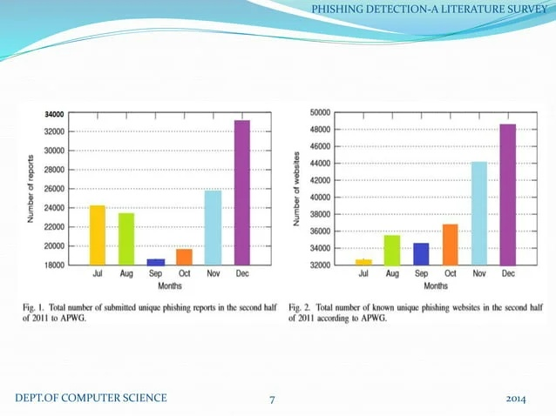
Chart Representation

Slide 10
MITIGATION OF PHISHING ATTACKS
Once the phishing attack is detected, a number of actions could be applied against the campaign. The following categories of approaches exist:
Detection approach
Offensive defence approach
Correction apporach
Prevention approach

Slide 11
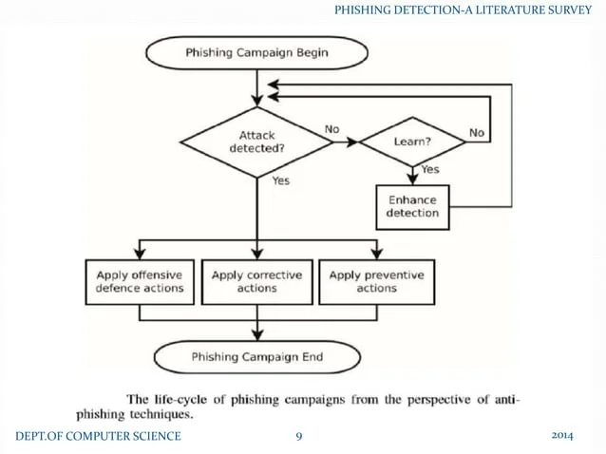

Slide 12
(1) DETECTION APPROACHES
User training approaches – end-users can be educated to better understand the nature of phishing attacks, phishing and non-phishing messages.
Software classification approches- these mitigation approaches aim at classifying phishing and legitimate messages on behalf of the user in an attempt to bridge the gap that is left due to the human error or ignorance.

Slide 13
(2)OFFENSIVE DEFENCE APPROACH
Offensive defence solutions aim to render phishing campaigns useless for the attackers by disrupting the phishing campaigns,
This is often acheived by flooding phishing websites with fake credentials so that the attacker would have a difficult time to fine the real credentials.
Example,BogusBiter: A browser toolbar that submits fake information in HTML forms whenever a phishing web site is encountered.

Slide 14
(3)CORROSION APPROACH
Correction is the act of taking the phishing resources down. This is often achieved by reporting attacks to Service Providers. Phishing campaigns often rely on resources, such as:
Websites
E-mail messages
Social networking services
In order to correct such attempts
Removal of phishing content from websites, or suspension of hosting services.

Slide 15
(4)prevention approaches
The "prevention" of phishing attacks cand be confusing , as it can mean different things depending on its context:
Prevention of users from falling victim- in this case, phishing techniques will also be considered prevention techniques.
Prevention attackers from starting phishing campaigns- law suits and penalties against attackers by Law Enforcement Agencies(LEAs) are considered as prevention techniques.

Slide 16
DETECTION OF PHISHING ATTACKS
Passive and Active Warnings
Passive warnings-the warning does not block the content-area and enables the user to view both the content and warning.
Active warnings-the warning blocks the content data, which prohibits the user from viewing the content-data while the warninig is displayed

Slide 17
GOOGLE SAFE BROWSING API
Enable client application to validate whether a given URL exists in blacklists that are constantly updated by Google.
The current implementation of the protocol is provided by Google.
The API requires client applications to communicate with providers through HTTP while adhering to syntex specified in protocol v2spec

Slide 18
ALGORITHM 1 PROTOCOLV2SPEC PHISING DETECTION IN PSEUDO-CODE
Hf←sha256(URL)
Ht←truncate(Hf,32)
If Ht H1 then
for Hr←queryProvider(Hr) do
if Hf=Hr then
warnPhishing(URL)
end if
End for
End if

Slide 19
VISUAL SIMILARITY
Classification with Discriminative key point features.
This mechanism is agonistic to the underlying code or technology that renders the final visual output to the users eyes.
Mimics a website using img tag.
Snapshot is then matched with whitelist.

Slide 20
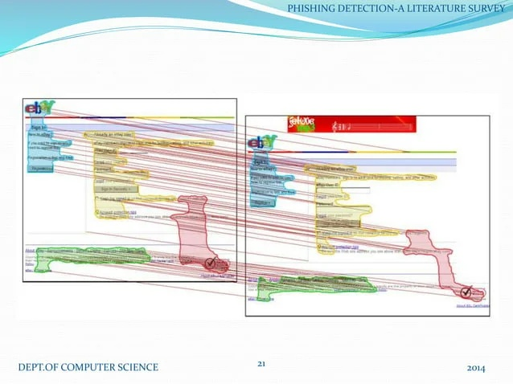

Slide 21
EVALUATION
The study concluded that user training approaches are promising.virtually user training approaches TP rate.
Blacklists are able to achieve low FP rates. Ineffective against zero-hour attacks.
The effectiveness of visual similarity techniques might not be accurately known,but rather assumed.

Slide 22


Slide 23
CONCLUSION
Phishing is a growing crime and one of that we must be aware ofs.Although laws have been enacted , education is the best defence against phishing.Beging a bit suspicious of all electronic comminications and websites is recommented. Lookout for the common characteristics sense of urgency,request for verification,amnd grammer and spelling errors.also,get in the habit of comparing the provided URL with the an independent search for the company’s website.

Slide 24
REFERENCES
Mohmoud Khonji, yourssef Iraqi, Senior Member, IEEE and Andrew Jones, IEEE COMMUNICATIONS SURVEYS & TUTORIALS, VOL.15, NO.4. FOURTH QUARTER 2013.
B.Krebs, “HBGary Federal hacked by Anonymous”,
http://Krebsonsecurity.com/2011/02/hbgary-fedral-hacked-by- anonymous/,2011,accessed December 2011.

Slide 25
Thank You

